Slide 1

Predictive Analysis for Breast Cancer: A Machine Learning Approach
Presented by Kareem Ameerah,
Matric Number: 22/11469.
This presentation outlines a groundbreaking machine learning approach to breast cancer prediction.

Slide 2
Introduction
Global Impact
Leading cause of death among women worldwide.
Late Diagnosis Challenge
Over 70% of cases in Nigeria diagnosed at Stage 3 or 4.
Clinical Bottlenecks
High workloads and delays for lab personnel.
AI-Powered Solution
AI system for early screening of breast aspirate samples, predicting malignancy.

Slide 3
Problem & Objectives: Bridging the Diagnostic Gap
Problem Statement
Project Objectives
Late diagnosis = poor patient outcomes.
Build supervised ML model for FNA features.
Laboratories lack fast, intelligent screening tools.
To support laboratory technicians with a system that speeds up their workflow.
Increase early detection, reduce delays.

Slide 4










Methodology: From Data to Deployment
Preprocessing
Data Acquisition
Label & one-hot encoding, StandardScaler scaling.
Real-world dataset from ULTRAMEDIKX, Kano.
Model Training
Logistic Regression, SVM, Deep Learning, etc.
Deployment
Intuitive Streamlit app for lab integration.
Best Model
Deep Learning with Keras (2 hidden layers, dropout).

Slide 5
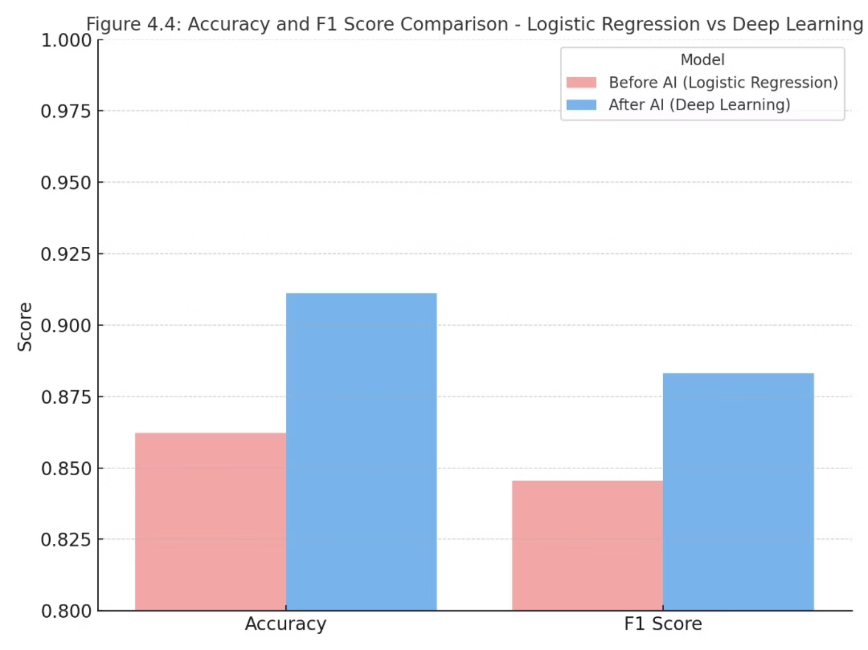
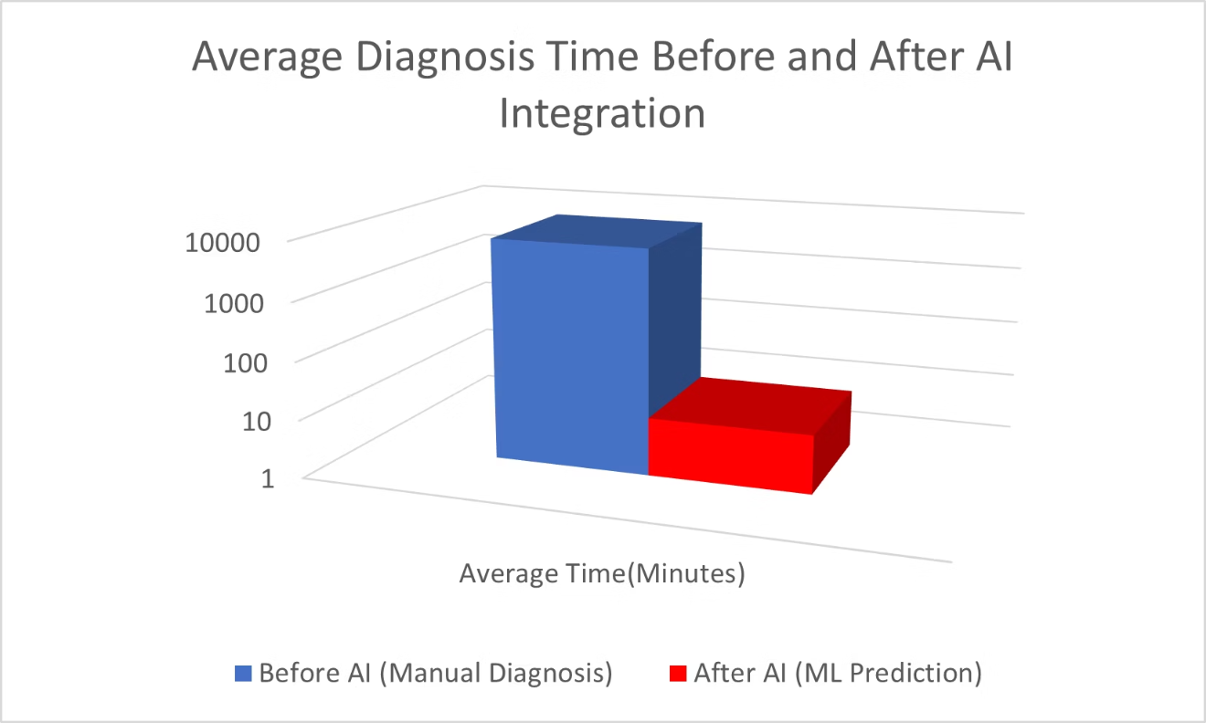
Results: Enhanced Accuracy and Speed
Performance comparison
Diagnosis Time Comparison

Slide 6

Conclusion
Lab Technician Support
Pre-screens aspirate samples, enhancing workflow efficiency.
Accelerated Interventions
Faster detection leads to earlier and more effective treatments.
Scalable System
Designed for widespread implementation.
Efficient Healthcare Delivery
Promotes better care, especially in low-resource settings.
This project proves that even simple clinical data, when paired with AI, can save lives.

